Slide 1


Department of Artificial Intelligence and Data Science
E-Commerce Customer Churn Prediction
Visweswar - 231801902 Sanjay N - 231801149
Bijlesh S - 231801501
Mr.Subramanian K

Slide 2
Problem Statement and Motivation
Problem Statement:-
In the competitive e-commerce industry, retaining existing customers is more cost-effective than acquiring new ones. However, identifying customers who are likely to stop using a platform (i.e., churn) is challenging due to massive amounts of transactional and behavioral data. Predicting churn early can help companies design targeted retention strategies.

Slide 3
Problem Statement and Motivation
Motivation:-
To reduce business losses caused by customer attrition.
To provide data-driven insights for improving marketing and loyalty programs.
To enhance customer satisfaction through proactive engagement.
To utilize Big Data tools to analyze large-scale customer behavior efficiently.

Slide 4
Objectives
To collect and preprocess large volumes of customer transaction and interaction data.
To use Big Data frameworks (Hadoop, Spark) for scalable data storage and analysis.
To build a predictive model that identifies customers at high risk of churn.
To analyze behavioral patterns influencing churn using Machine Learning and NLP (e.g., reviews, feedback).
To visualize churn trends and provide actionable insights for business decisions.

Slide 5
Abstract
This project aims to develop a Big Data-based predictive model to identify customers who are likely to churn from an e-commerce platform. Using tools such as Apache Spark, Hadoop, and Machine Learning algorithms (e.g., Logistic Regression, Random Forest, XGBoost), the system processes large datasets containing user transactions, browsing history, and engagement metrics. By leveraging distributed computing, the model ensures scalability and high performance in real-time churn prediction. The results can help businesses improve customer retention strategies, increase profitability, and deliver better user experiences.

Slide 6
Implementation
Steps:
Load customer data from CRM and transaction records
Preprocess data: handle missing values, encode categories, scale features
Train ML models (Logistic Regression, Random Forest, XGBoost)
Evaluate performance using accuracy, precision, recall, AUC
Export churn predictions to CSV/JSON
Create visualizations using Matplotlib & Seaborn
Integrate results into an interactive HTML dashboard

Slide 7
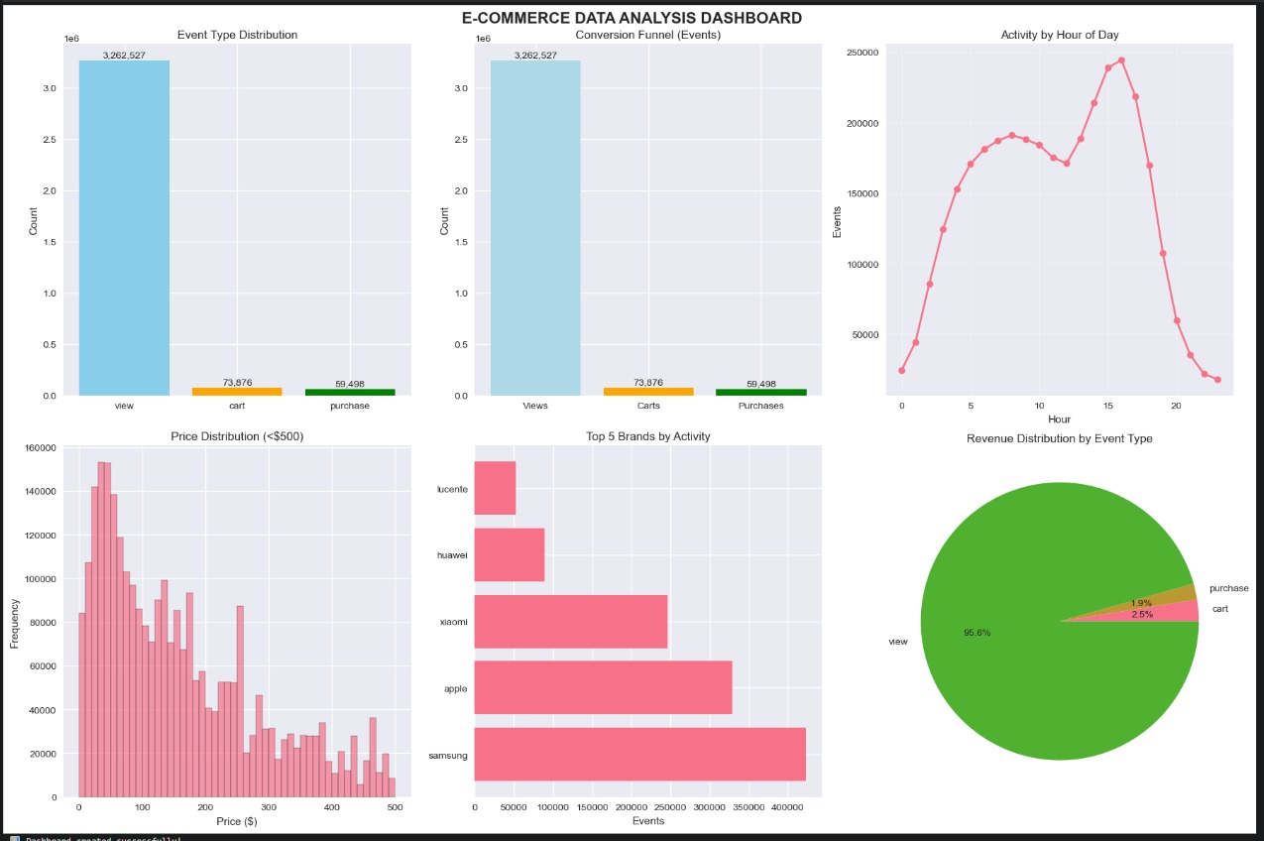
Dashboard Visualization

Slide 8
Results
Key Findings:
Customers who make fewer purchases or show reduced activity are at higher risk of churn.
The conversion funnel shows a sharp drop from views to purchases, indicating engagement loss. Peak customer activity occurs between 10 AM and 4 PM, suggesting ideal engagement hours.
Insights:
Visualization helps businesses identify churn-prone customer segments.
Enables targeted retention strategies through timely offers or personalized communication.
Supports data-driven decision-making to improve overall customer satisfaction and reduce churn rates.

Slide 9
Existing System
Many e-commerce platforms still use basic analytics or manual methods to track customer activity.
Traditional Machine Learning models often fail to handle massive and real-time data streams.
Existing churn prediction models are not scalable and lack personalization.
No integration with Big Data ecosystems (like Hadoop, Spark, or Kafka) for efficient computation.

Slide 10
Conclusion & Future Scope
Conclusion:
The system provides a simple and efficient way to analyze and visualize customer churn trends.
It integrates data collection, preprocessing, model training, and dashboard visualization in a single pipeline.
Helps organizations understand customer behavior, predict churn risk, and take proactive retention actions.
Future Enhancements:
Implement real-time churn prediction using streaming data.
Expand the model with deep learning and sentiment analysis for more accurate predictions.

Slide 11
Thank You

